Slide 1
Turk Talk: A Hybrid approach to teaching therapeutic communication
Presented by Michelle Cullen, RN & David Topps, MD
There is no conflict of interest to declare

Slide 2
Incorporate language into simulation, to develop contextually relevant therapeutic communication skills
Notes:
I would like to share with you today how we have developed a tool that allows students to practice contextually relevant therapeutic communication skills that is sustainable and cost-effective.
Incorporating language into simulation provides opportunities for implementation and evaluation
To date, standardized patients have been the only way students can practice interventions where communication is a critical component of the intervetnion. This is expensive and resource intensive
Incorporate language into simulated scenarios
Intentionally develop therapeutic communication that is context relevant

Slide 3
Notes:
What we teach them in theory class
Undergraduate students learn about therapeutic communicate in class (verbal and non-verbal, open and close ended questions, reflective listening) However, …. Next slide

Slide 4
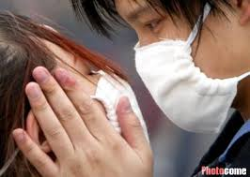
Notes:
….Students often struggle with how to contextualize these skills relevant to the setting, events, culture, and the specific patient/family
Language is used in every step of the nursing process.
Therapeutic communication builds rapport, forms the nurse-patient relationship, defines the work that will be done, as well as the context, ….next slide

Slide 5
creating change
creating change
Notes:
… and in Mental Health language is the medium for doing the work
It is used to challenge the status quo, imagine new perspectives, and to engage patients in thinking or behaving differently. LANGUAGE IS A CHANGE AGENT

Slide 6
Turk Talk:
A means of incorporating human interaction within a computer based simulation
Notes:
Turk Talk: A means of incorporating human interaction within a computer based simuilation

Slide 7
J: I am not able to pay my phone bill on line
O: Please enter your 11 digit phone number
S: 403-675-8888
O: I am retrieving your account. Please wait.
A: I made a payment of $45 yesterday.
O: I don’t have a record of that transaction.
Notes:
Multiple users at different points in the process
Text talk with phone or cable support
delays in response b/c handling multiple requests
Students engage a simulated activity and a human mediates when interpretation and context relevant responses are required
Because having a machine interpret language is not effective

Slide 8
Do we have a simpler version of the first three lines of this chart
Notes:
Example of the case design for Turk talk.
Unfolding cases with branching decision matrix
Allows the student to progress through all of the steps in the nursing process or to focus skill development in a particular area (layering of learning)
Combination of multiple choice questions, drag and drop, which are effective methods that allow students to
recall theoretical information that they would apply to the particular case
Analyze and synthesis the information in order to prioritize patient care
Note: these are the steps that current VP simulations currently address
Within each case, turk talk is included at pivotal points where interpretation becomes a pivotal point and may determine the direction of care

Slide 9
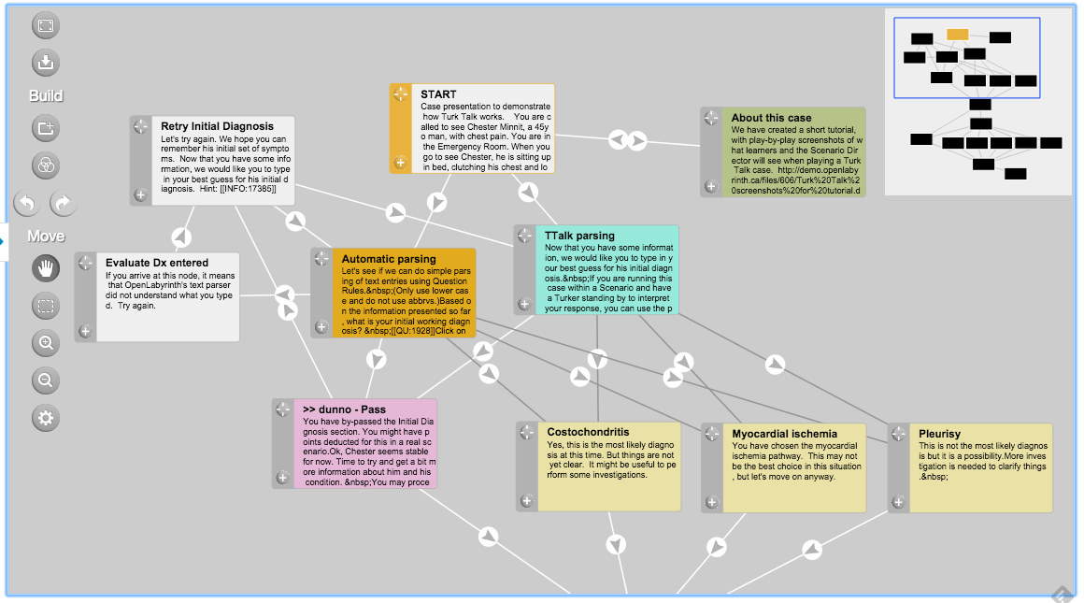
Simpler graph of 1st 3 rows

Slide 10
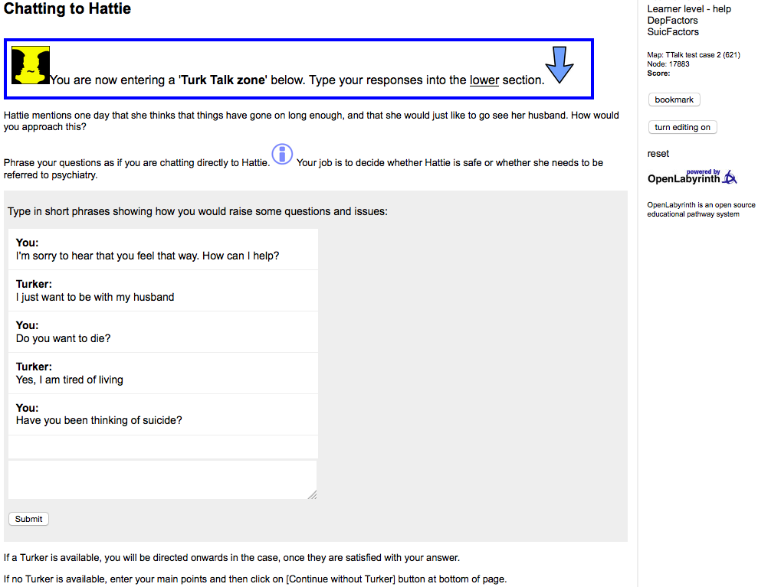
Notes:
Opportunities to practice without being cued
Beginning with text allows for some time to think about what will be said (vs. face to face where there is more of a tendency to speak what initially comes to mind)

Slide 11
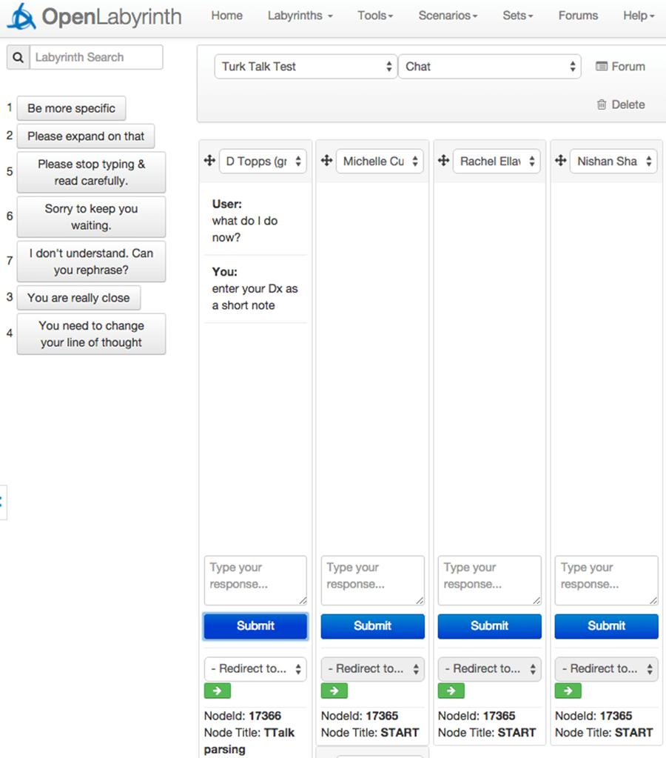
INSERT screen shot of the facilitators screen
Notes:
The human facilitator is able to provide feedback, ask for clarification, or move the student to next node
The ability to
provide a combination of feedback (“not quite it”, “more information”) preprogrammed for “select-an-answer” if they choose wrong or a better answer is available
Be the patient - tailored responses for “free text box” when they are asked to interact with the patient

Slide 12
Supportive Feedback
Immediate or delayed
Individual or group
Include reflective practice
Notes:
Evaluation
Formative or Summative
Immediate or delayed
Individual or group
Include reflective practice

Slide 13
Managing Complexity
Notes:
Adaptive and could include varying levels of complexities (based on theroretical knowledge, level of acuity, available resources)
Managing Complexity

Slide 14
Accessible
Avoid space constraints
Staggered start times
Individual or group
Notes:
Avoid space constraints – no need to book large classrooms on campus
Accommodate on-line or blended learning approaches
Can be used by groups (case study in a lecture) or individuals (clinical or lab activity)

Slide 15
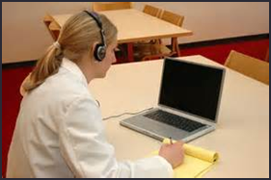
Location
Notes:
Not restricted by location

Slide 16
Cost Effective
OpenLabyrinth
Faculty expertise
Personal computer
Notes:
Cost effective
free and open-source OpenLabyrinth platform
No need to hire and train actors for standardized patients – faculty have the expertise
Technical training for facilitators is minimal and has been describe as intuitive
point and click
opportunity for new facilitator to work as a co-facilitator
Does not required specialized equipment

Slide 17
What we have learned
Response types
Terminology
Complexity
Facilitator Training
Notes:
What we have learned
Response types
Cued versus Turk talk (free text)
10% of responses are turk talk and this allows for reasonable delays related to directing multiple participants
Terminology
Allows for interpretation when various terms can relate to the same topic
Complexity
Ability to increase or decrease by adding/removing resources, including co-morbid/concurrent disorders
Facilitator Training
Easy to learn
Point and click approach
Being familiar with the screen and script
Co-facilitate assists with consistency in approaches

Slide 18
I really realized in a new way that it’s not just bad skills that can cause unsafe situations but words as well.
3rd year nursing student

Slide 19
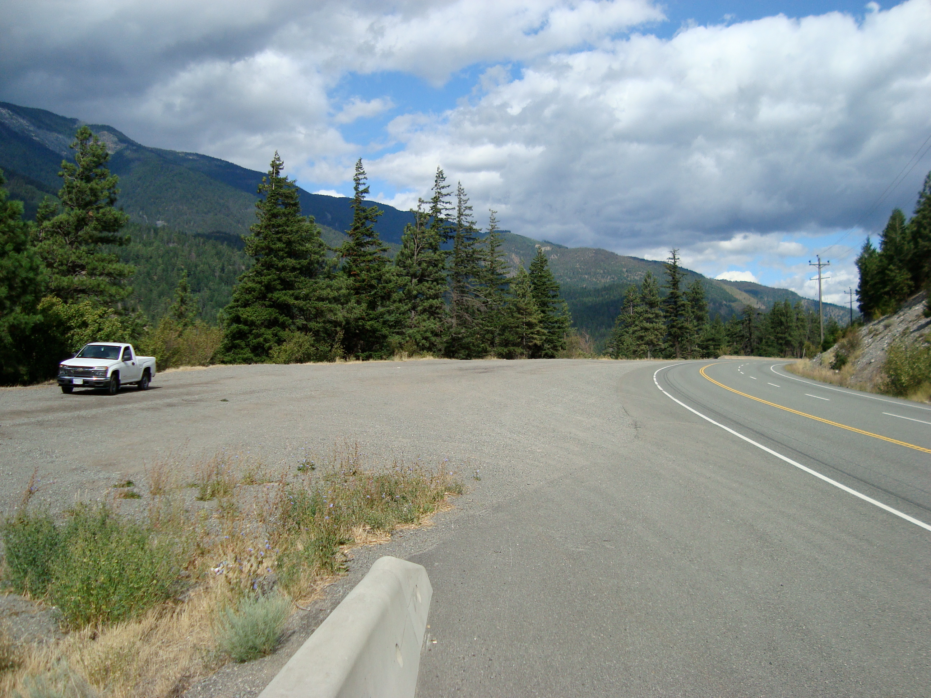
Looking Ahead
Fine tune the process
Develop scripts
Explore the parameters
Notes:
Tiny.cc – needs to point to a web page (open lab)
Word Press website – david to give login

Slide 20
Thank you/Acknowledgements
Support for development of OpenLabyrinth as an educational research platform, exceeding its original roots as a virtual patient authoring application, has been provided through a variety of research and development grants.
OpenLabyrinth is free open-source, open-standard, web-based software. Its development is guided by the OpenLabyrinth Development Consortium, including the University of Calgary, St George’s University London, Karolinska Institut, Aristotle University Thessaloniki, and Queens University Ontario.
Notes:
David Topps for collaborating and creating a teaching tool that engages students to provide excellent patient care
Dr. Andrew Estephan for
Dr. Graham McCaffery

Slide 21
Want to know more
Contact Michelle Cullen at mcullen@ucalgary.ca
Tiny.cc – needs to point to a web page (open lab)
Notes:
What was to be on that web page… or is it just the http://openlabyrinth.ca main page? I forget

